Slide 1

J2EE
WEB COMPONENT IN J2EE modulle

Slide 2
Session Objectives
Introducing the web technology
Aware of stand-alone and web application
importance of Http protocal
Aware of J2ee architecture

Slide 3
Agenda
Describe Internet services
Describe the World Wide Web
Distinguish between web applications and web sites
Gateway Interface (CGI) scripting
Servlet and its advantages
Describe the Java™ 2 Platform, Enterprise Edition
(J2EE™ platform)

Slide 4
Topic 1: Networking Layers
File Transfer Protocol (FTP)
runs in the application layer
Transmission Control Protocol (TCP)
runs on top of the Internet Protocol
Internet Protocol (IP) The wires
Applications (browsers , HTML, and so on)
Hypertext Transfer Protocol (HTTP),
in application layer
APPLICATIONS
FTP
HTTP
TCP
TCP
NETWORKING SOFTWARES
NETWORKING SOFTWARES
PHYSICAL LAYERS
PHYSICAL LAYERS

Slide 5
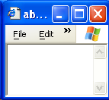
Working of a Web Application
2, Web Server
1. User Request
retrieving
requested static
The
web page
Internet
File
3. Reply
System
Web
Server

Slide 6
Hypertext Transfer Protocol
Hyper Text Transfer Protocol or HTTP is the protocol used by the world wide web
The Hypertext Transfer Protocol (HTTP) supports serving up documents in the Hypertext Markup Language (HTML):
HTML documents include links to other web documents.
Web documents can also include forms to pass data from the user to the web server.
HTTP can serve any type of document.
The Multipurpose Internet Mail Extensions (MIME) specification defines a canonical naming convention for documents of various media.

Slide 7
HTTP Request
The following is the request generated by Internet Explorer when the URL was http://www.yahoo.com
HTTP Method
Request-URI
Protocol version
GET http://www.yahoo.com/ HTTP/1.0
Accept: image/gif, image/x-xbitmap, image/jpeg, application/vnd.ms-excel, application/vnd.ms-powerpoint, application/msword,application/x-shockwave-flash, */*
Accept-Language: en-us
User-Agent: Mozilla/4.0(compatible; MSIE 6.0; Windows NT 5.1)
Host: www.yahoo.com
Header

Slide 8
HTTP Response
The server processes the request and sends a Response
The following is an example of a response
Status Line
  HTTP/1.1 200 OK
  Date: Sat, 18 Mar 2000 20:35:35 GMT
  Server: Apache/1.3.9 (Unix)
  Last-Modified: Wed, 20 May 1998 14:59:42 GMT
  Content-Length: 2000
  Content-Type: text/html
  <HTML><HEAD> </HEAD> <BODY>
  …
  </BODY> </HTML>
Header
Message Body -Actual Data

Slide 9
Http protocol methods
Http Methods
Get
Post
Get is the default method
The GET method means retrieve whatever information
(in the form of an entity) is identified by the Request-URI
Get Method is Idempotent
Get method carry only 266 characters at a time
In post method Data is not Visible
You can send huge amount of data through post method

Slide 10
Topic 2 : Websites and Web Applications
Web Applications and Web Sites:
A web site is a collection of static HTML pages.
A web application is a web site with dynamic
functionality on the server (or sometimes on the client
using applets or other interactive elements).
Web applications use HTML forms as the user interface
to code that is running on the server:
Data is passed from the HTML form to the server
using the CGI.
The CGI data is sent in the HTTP request stream.

Slide 11
Static Page Vs Dynamic Page
From the web, we get static pages as well as dynamic pages
Static Page | Dynamic Page
Can be created and stored in web server in advance as HTML file. | Can NOT be created and stored in web server in advance as HTML file.
Static page does not change with user and/or time. | Dynamic page changes as per the user and/or time.
For delivery of static page, all we require at server side, HTML files in Web Server. | For delivery of dynamic page, apart from Web Server, we require program to generate dynamic content.
The software component that runs the server side program to generate the dynamic content is known as the Web Container

Slide 12
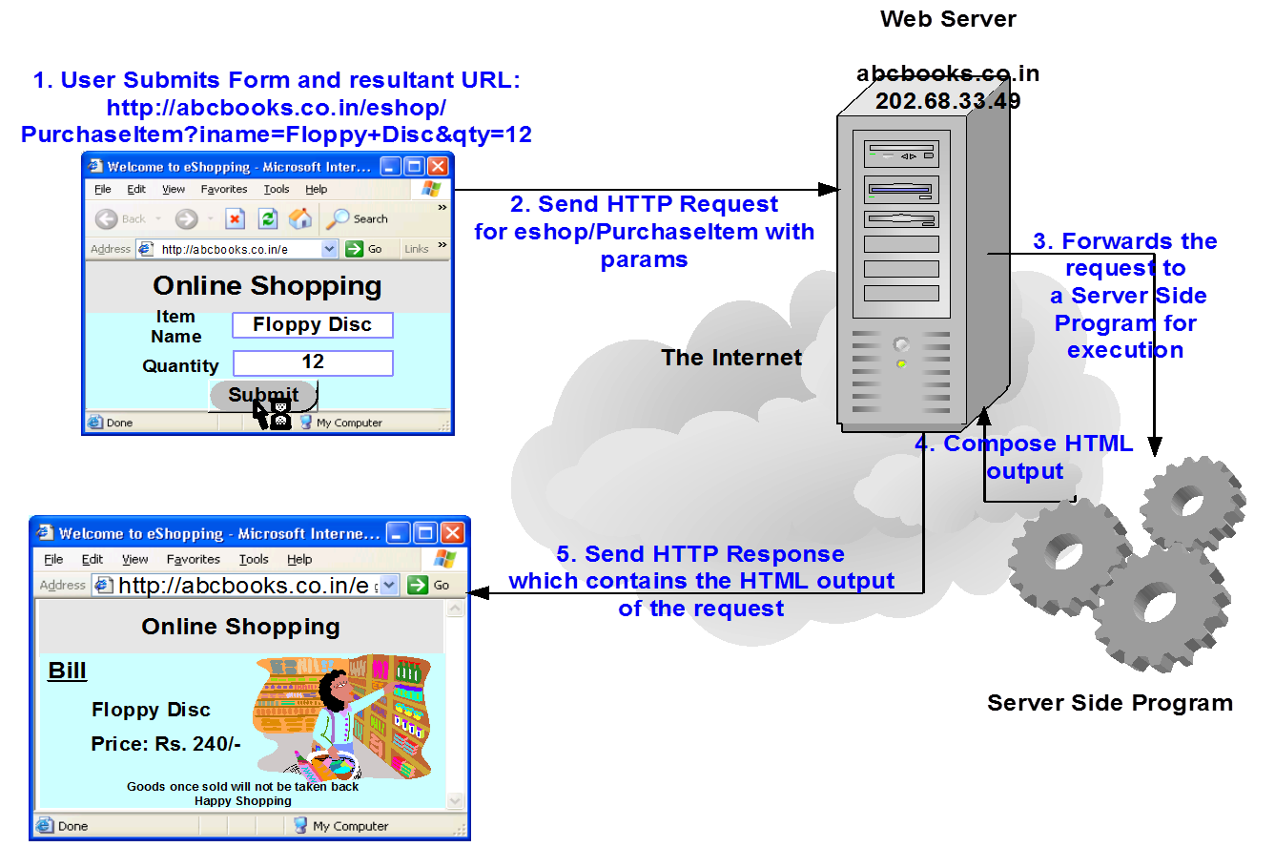
Generation of Dynamic Pages

Slide 13
server
Types of Servers
Webserver
Application server

Slide 14
Resource Utilization of CGI
CGI Program in Server
For each request CGI program will create one processes shell.
Request
CGI Shell
httpd
CGI Program

Slide 15
Resource Utilization of CGI
CGI Program in Server
Request
Request
Request
CGI Program
httpd
CGI Shell
Each request from user will create a process

Slide 16
Advantages and Disadvantages of CGI
CGI program advantages:
Written in a variety of languages
Relatively easy for a web designer to reference
CGI program disadvantages:
Each shell is heavyweight
Not scalable
CGI processing code (business logic) is mingled
with HTML (presentation logic)
Language is not always secure or object-oriented
Language is not always platform independent

Slide 17

Servlets

Slide 18
Java Servlets
A servlet is a Java technology component that executes on the server.
Servlets perform tasks similar to those performed by
CGI programs, but servlets execute in a different environment.
Servlets perform the following:
Process the HTTP request
Generate the HTTP response dynamically
A web container is a special Java™ Virtual Machine
(JVM™) that is responsible for maintaining the life
cycle of the servlets, as well as issuing threads for each
request.

Slide 19
Resource Utilization of Servlet
Each Request from the user will create a thread in Servlet
Thread is light weight but process is heavy weight
Request
Request
servlet
Request
Web container

Slide 20
Advantages and Disadvantages of Servlets
Java servlet advantages:
Performance (threads are faster than processes)
Scalable
The Java programming language is robust and object-oriented
The Java programming language is platform Independent
Java servlet disadvantages:
Separation of concerns: business and presentation logic
Concurrency issues

Slide 21
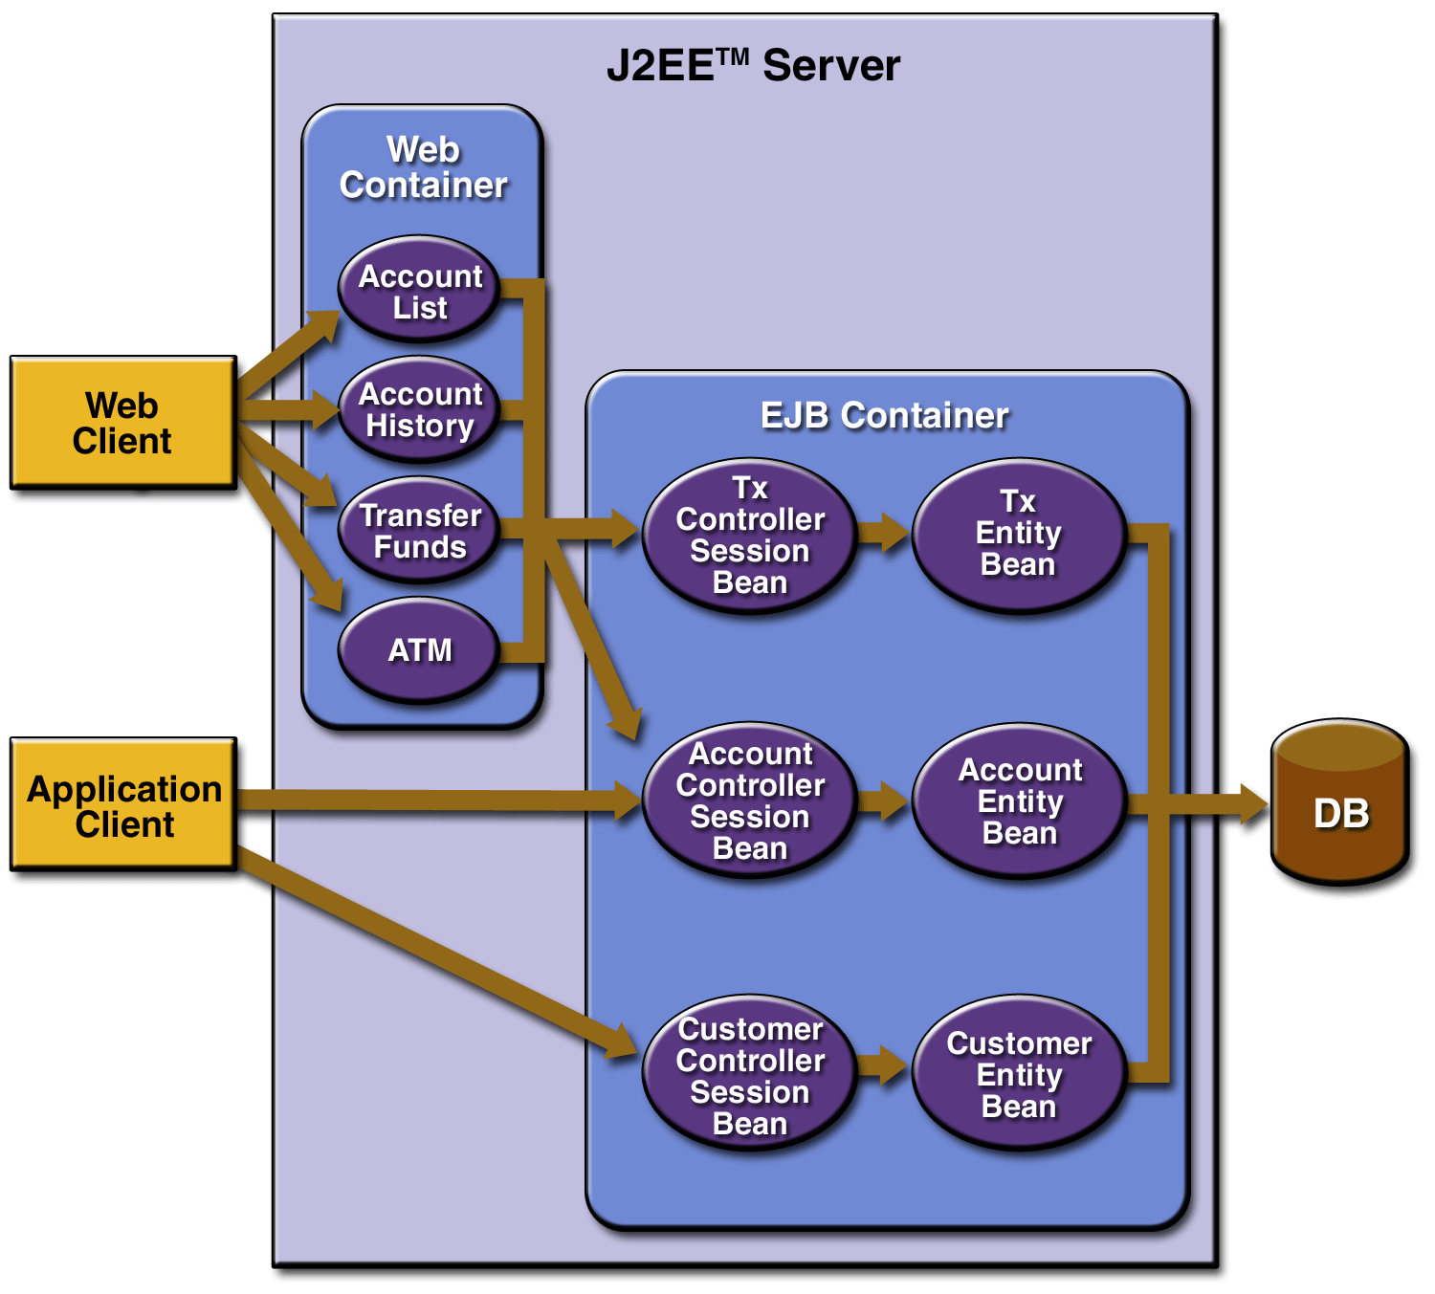
J2EE Architecture
J2EE Architecture Contains Container, Component and services

Slide 22


Servlet Life Cycle
Load servlet class.
2. Create servlet instance.
3. Call the init method.
4. Call the service method.
5. Call the destroy method.
Call the init method
Call destroy method
Call service method

Slide 23
Servlet Package
javax.servlet package:
javax.servlet.Servlet
javax.servlet.ServletRequest
javax.servlet.ServletResponse
javax.servlet.ServletConfig
javax.servlet.ServletContext
javax.servlet.http package:
javax.servlet.Servlet.http.HttpServlet javax.servlet.Servlet.http.HttpServletRequest
javax.servlet.Servlet.http.HttpServletResponse

Slide 24
Request and Response
HttpServeltRequest
request.getParameter()
request,getParamaters()
request.getparameterNames()
HttpServletResponse
response.setContentType()
response.getWriter()

Slide 25
Simple servlet
import javax.servlet.http.HttpServlet;
import javax.servlet.http.HttpServletRequest;
import javax.servlet.http.HttpServletResponse;
import java.io.IOException;
import java.io.PrintWriter;
public class SimpleServlet extends HttpServlet
{
public void doGet(HttpServletRequest request, HttpServletResponse response) throws IOException
{
response.setContentType(“text/html”);
PrintWriter out = response.getWriter();
out.println(“<html>”);
out.println(“<head>”);
out.println(“<p>”);
out.println(“Welcome to First Servlet Session “);
out.println(“</p>”);
out.println(“</body>”);
out.println(“</html>”);
}
}

Slide 26

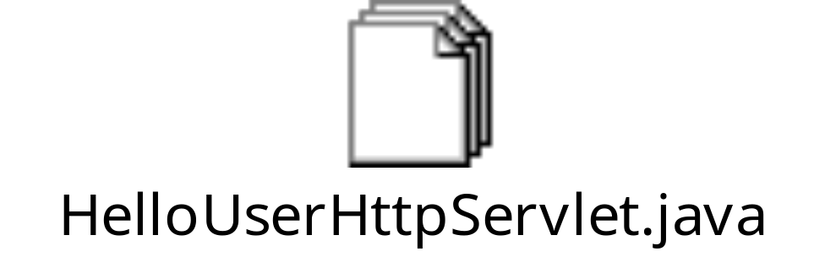
HttpServlet
  Current Time example with HttpServlet
  A Hello <UserName> example with HttpServlet
Simple servlet

Slide 27

Quiz

Slide 28
Quiz
1) Which of the following denote the type of servlet?
  GenericServle
  HttpServlet
  Both of the Above
  None of the Above

Slide 29
Quiz
2) Choose the false statement among these?
  Servlets have GUI interface
  b) Servlets are server side components
  c) Applets have GUI interface

Slide 30
Quiz
3) CGI Is safer than Servlet
  True
  False
Creation and destroy of objects in servlet will be taken care by
  Servlet
  Html
  Xml
  Container

Slide 31
Quiz
Get method is safer than post
  True
  False
6) In which method the data will be carried in the first line of the request object
  post
  Put
  Get
  Trace

Slide 32
Thank you

